Slide 1
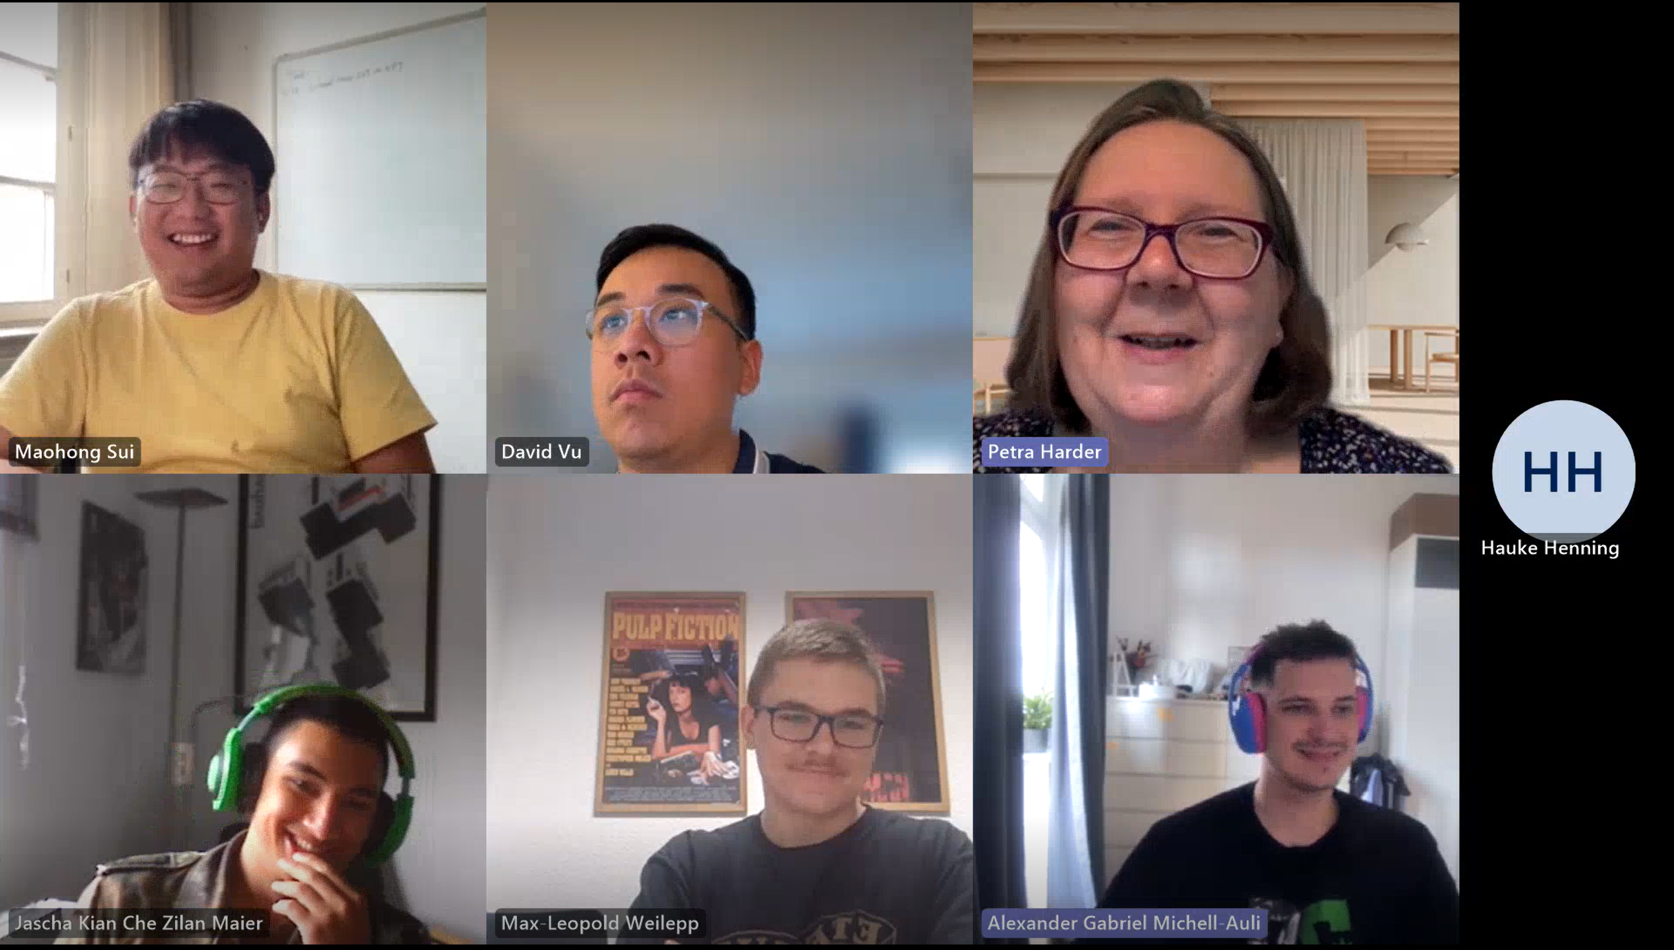
Engineering Matters Online
By Petra Harder BA, AKC

